Slide 1
Binary search tree(BST)
Insertion in BST
Deletion in BST
GUIDED BY: Presented By:
MAM. YASMEEN JANA Shumaila Bibi
SP22-BCS-075

Slide 2
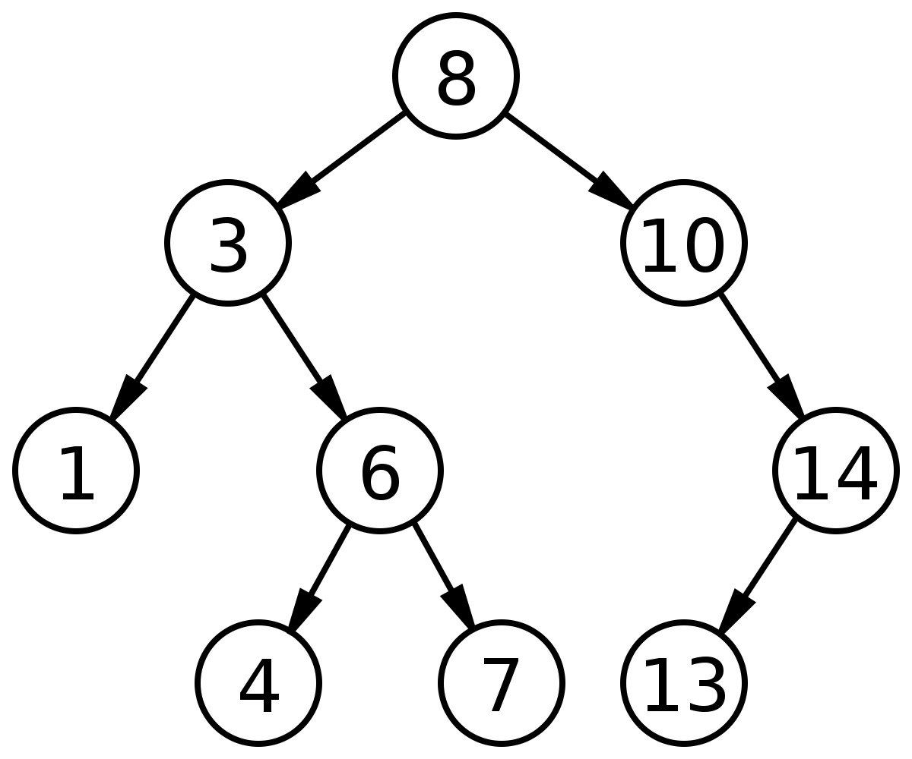
Binary Search tree
A binary search tree is a general tree where each data value of the left sub-tree must be less than the root value, each data value of right sub-tree must be greater than the root value and left & right sub-tree must be also a Binary Search Tree.

Slide 3
Binary Search tree
A node-based binary tree having following properties:
The left subtree contains only nodes with values lesser than root.
The right subtree contains only nodes with values greater than root.
The left and right subtree each must also be a binary search tree.

Slide 4
Types of binary search tree (BST)
Balanced Binary Tree(AVL)
Full Binary Tree (Complete)
Degenerate Binary Tree
Red Black Tree

Slide 5
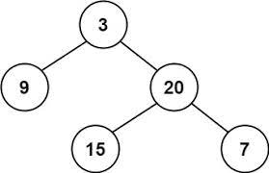
Balanced Binary tree(AVL)
A balanced binary tree is such a tree whose left and right sub-tree’s height differ by not more than 1. Height of AVL tree is (0,1,-1).
Formula of balanced factor is:
Balance factor = height of LST - height of RST

Slide 6
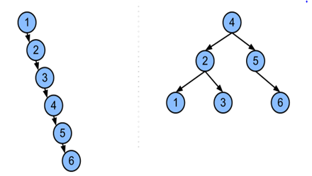
BALANCED BINARY TREE
Non- Balanced Balanced

Slide 7
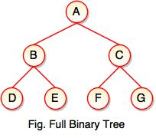
Full Binary Tree Full Binary tree
A complete binary tree(full binary tree) is a binary tree in which every node contains exactly two child nodes except the leaf node.

Slide 8
Operations of BST
Insertion in binary search tree
Deletion in binary search tree
Searching of binary search tree

Slide 9
Insertion in binary search tree
A new key is always inserted at the leaf by maintaining the property of the binary search tree.
Properties for insertion are:
Compare the inserting node to root node
If the inserting value is smaller to root node, we take the left sub-tree
If the inserting value is greater to root node, we take the right sub-tree

Slide 10
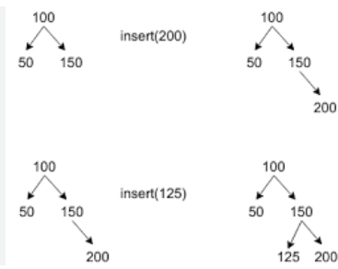
Insertion in binary search tree

Slide 11
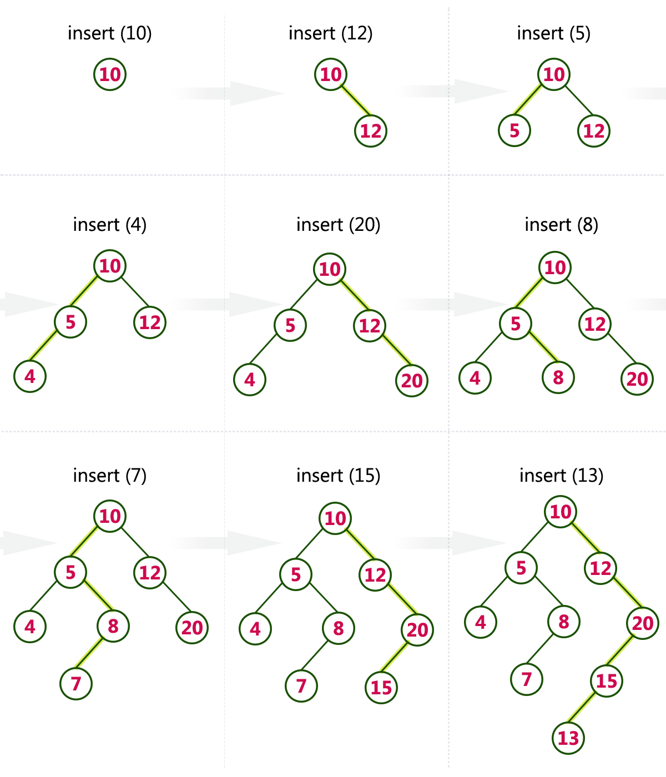
Example of BST elements are inserted in Binary search tree 10,12,5,4,20,8,7,15,13

Slide 12
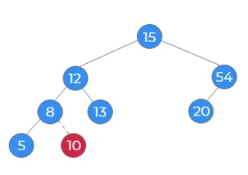
Algorithm – insertion in bst
Value to insert -10
Steps:
10<15. Move to left subtree
10<12. Move to left subtree
10>8. Move to right subtree
No node left
Insert 10

Slide 13
Deletion
Deletion function is used to delete the specified node from a binary search tree. For deletion we have to traverse all elements.
Causes:
Delete a Leaf Node or note with no child in BST
Delete a Node with single Child in BST
Delete a Node with Both Children in BST

Slide 14
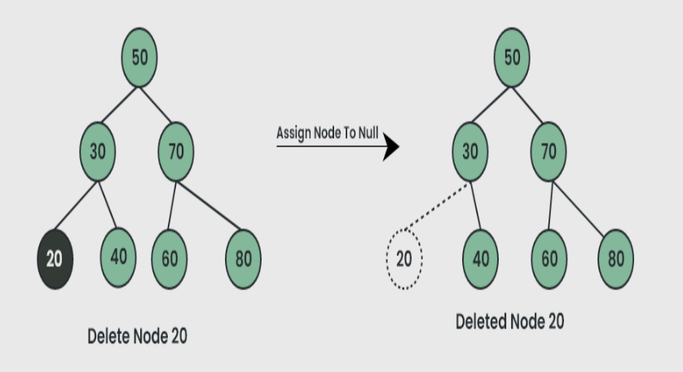
Case 1 Delete a leaf node in bst
Example

Slide 15
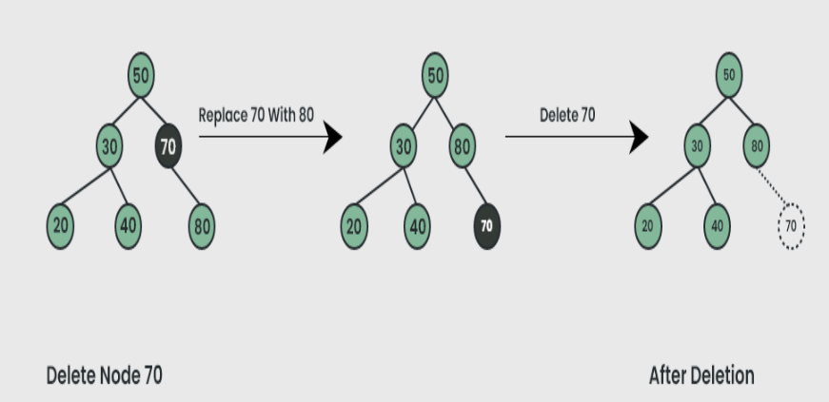
case 2 delete a node with single child in bst
Example

Slide 16
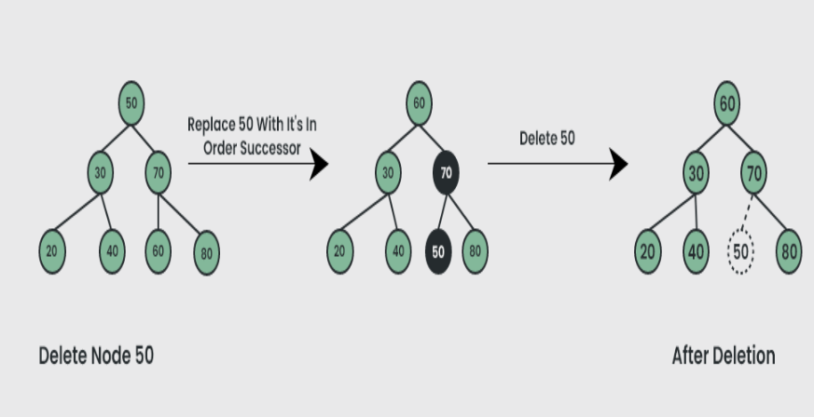
Case 3 delete a node with both children in bst
Example

Slide 17


